Slide 1
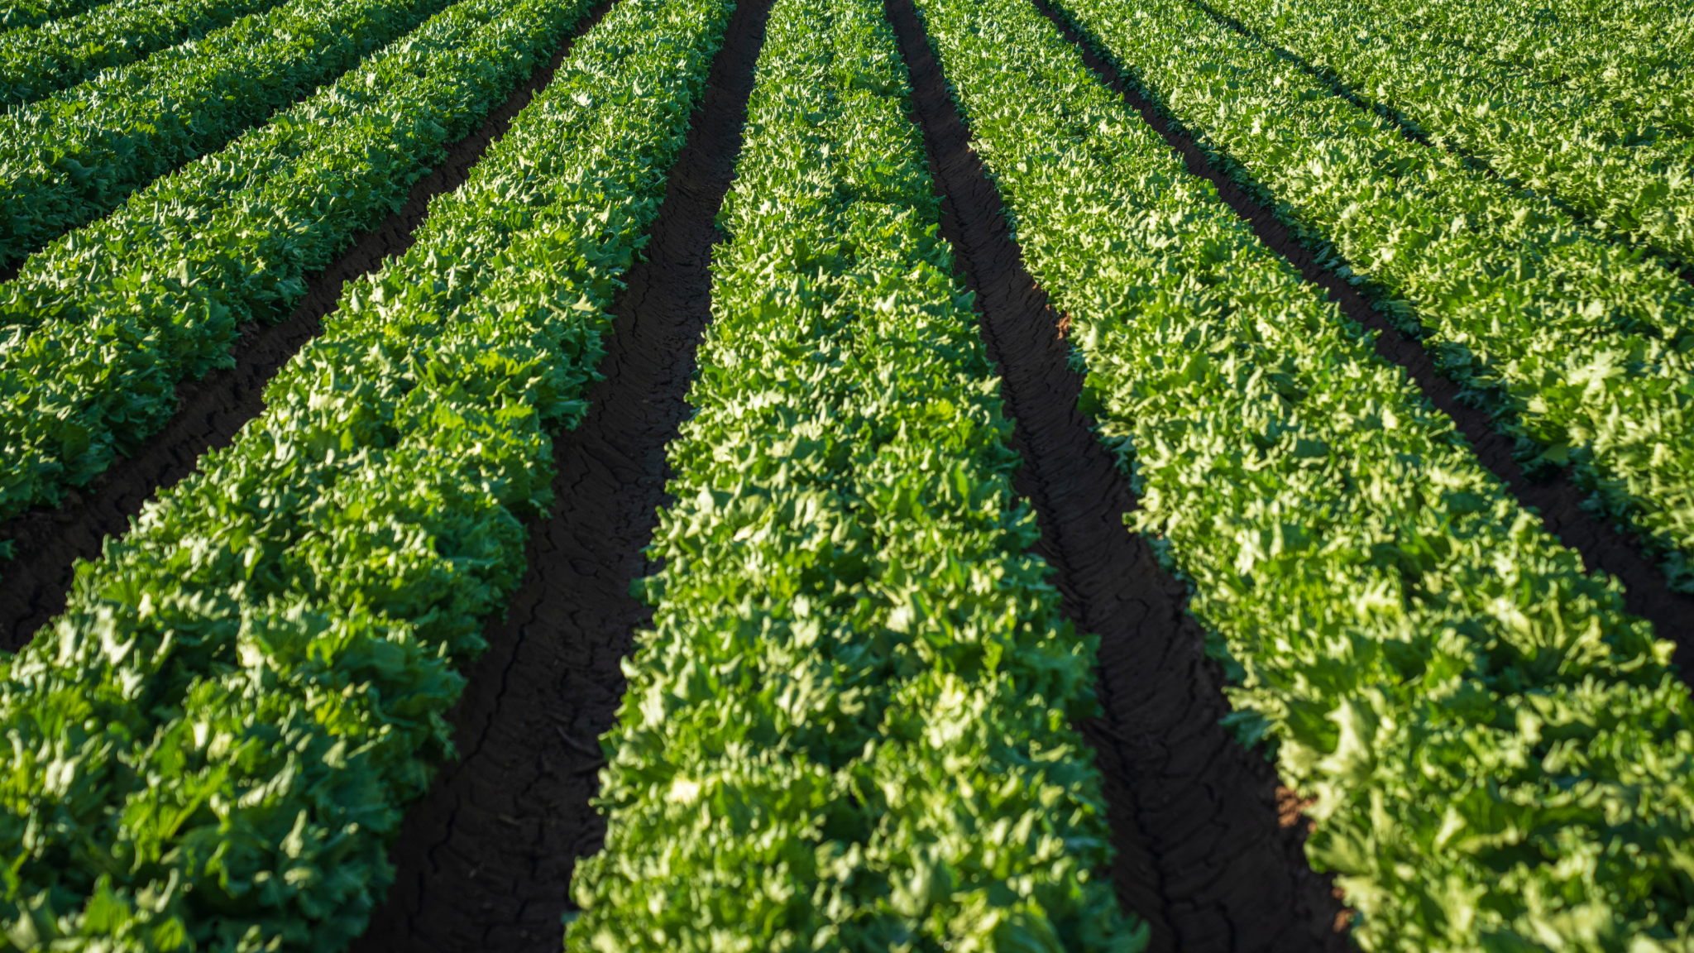
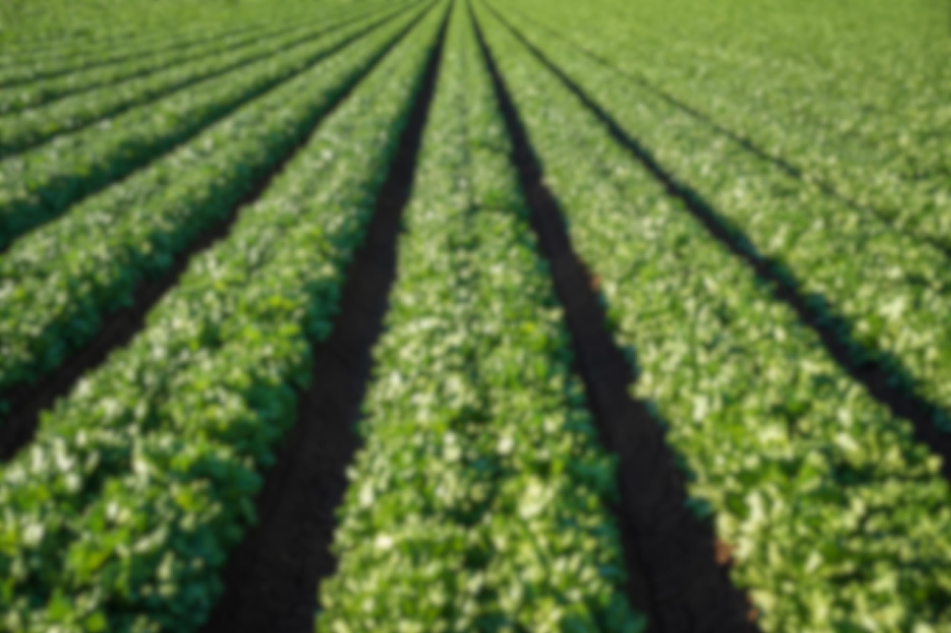
Smart Agricultural Monitoring

Slide 2
IoT based control and automation of smart irrigation system
Course Name: Introduction to computer systems (ECEN305)
Prof. Name: Dr/ Mohamed Saeed Darwesh
TA: Eng/ Kareem Mohamed Moussa
Team members:
Mohamed Tamer Shebita 211000379
Ahmed Salah Kamal 211001546
Jaser Osama Kasim 211001801
Zeiad Ehab Alfaham 212002283
Oussama Tharwat Ali 211000589

Slide 3
Table Of Contents
Introduction
Features
3. Methodology
4. Results

Slide 4
Traditional Monitoring System
Lack of Real-time Monitoring
Labor Intensiveness
Difficulty in Data Integration

Slide 5
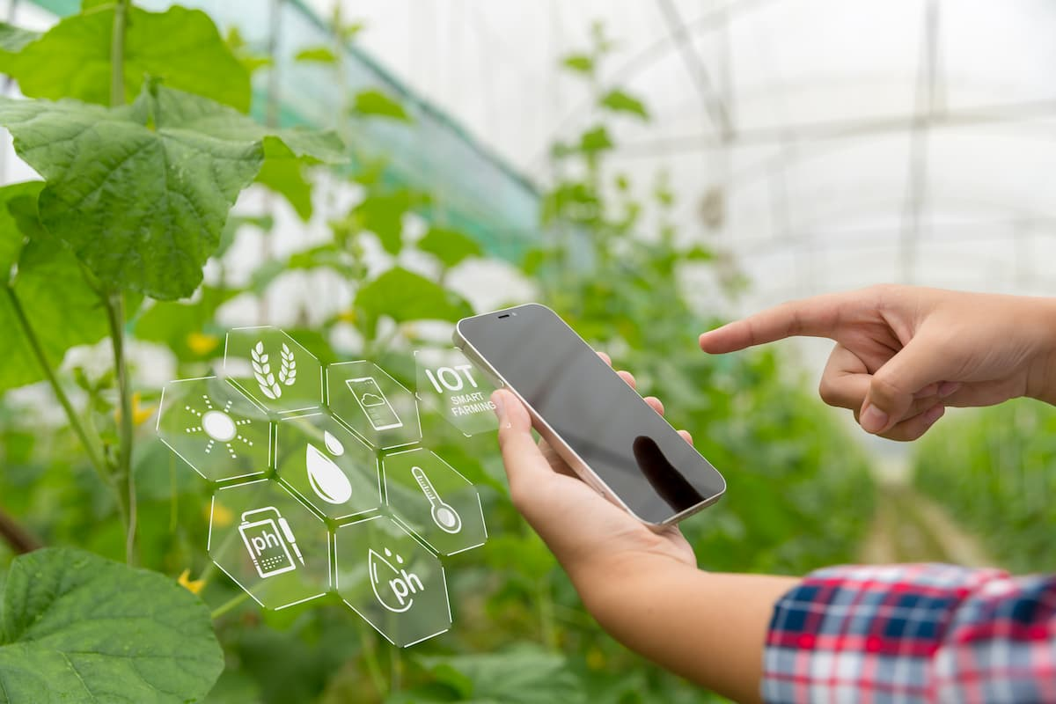
Our Solution
IoT-Based Smart Irrigation Control
“Empower your thumb with our cutting-edge system integrated with MOBILE APPLICATION, the ultimate companion in plant care!”

Slide 6
Features
Soil Moisture monitoring
soil moisture sensor
Temprature and Humidity monitoring
DHT11
Crop Monitoring and Security
PIR
Sunlight Monitoring
LDR (Photoperiod-sensitive Crops)

Slide 7
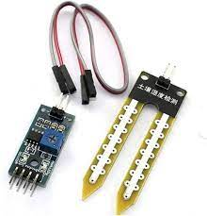
Soil Moisture monitoring
We used soil moisture sensor to monitor the water level of the soil.
By measuring the moisture levels in real-time, the smart irrigation system can intelligently assess the actual water needs of the plants. When the soil moisture falls below a predefined threshold, the system can automatically trigger the irrigation system to deliver the precise amount of water required for optimal growth.

Slide 8
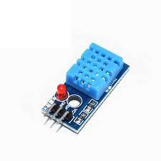
Temperature and Humidity monitoring
We use (DHT11) to monitor the temperature and humidity. It is specifically designed for measuring temperature and humidity levels, the DHT11 sensor provides accurate and real-time data that enables precise environmental control.

Slide 9
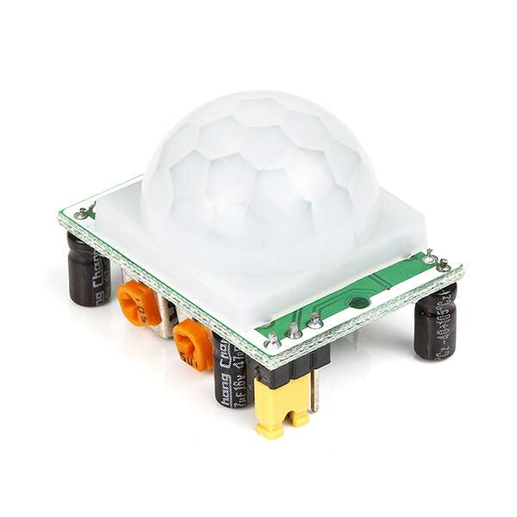
crop monitoring and security
We use (PIR sensor) to monitor the motions in the farm. the PIR sensor contributes significantly to creating responsive, intelligent, and energy-efficient environments. Its effectiveness in detecting motion make it an indispensable tool for applications requiring automated responses.

Slide 10
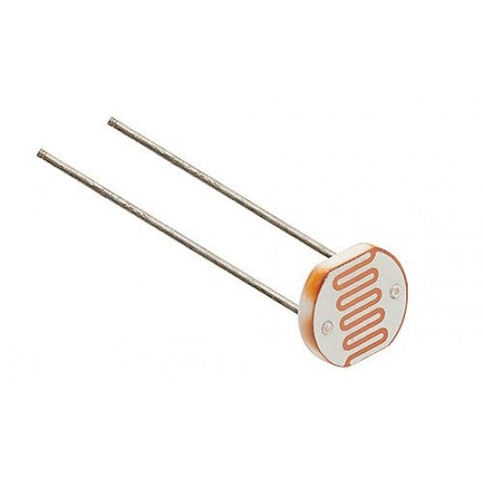
Sunlight monitoring
We use (LDR sensor) to monitor the light in the farm. It serves as a crucial component in numerous IoT applications, especially those focused on ambient light monitoring. We can take specific actions depending on the sensor output for watering or not.

Slide 11
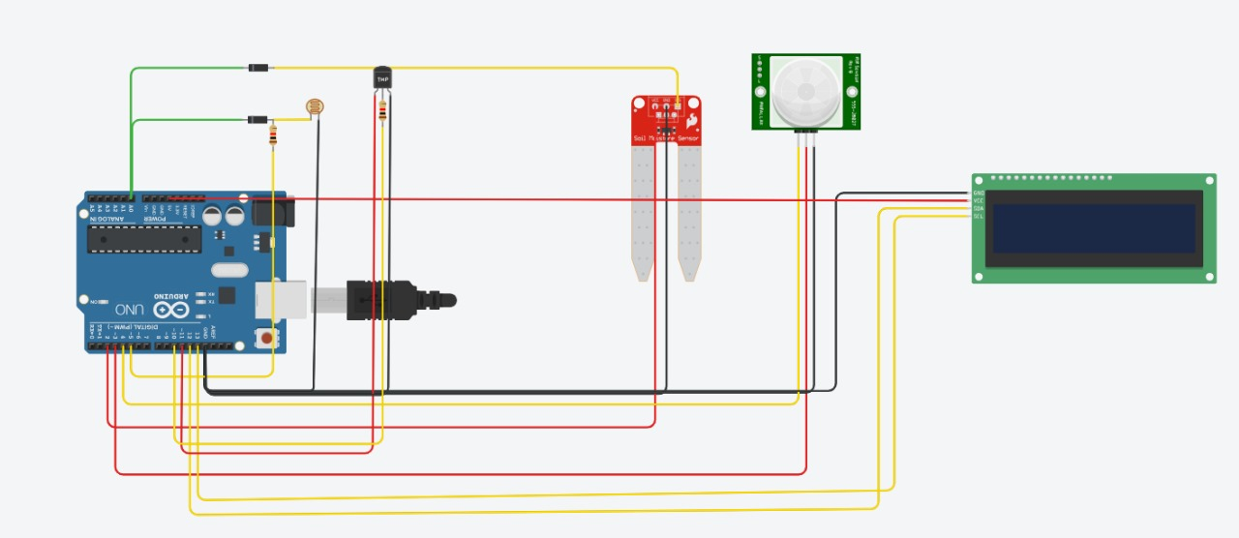
Methodology
We Use ESP8266 as a cheap microcontroller with WI-FI module.

Slide 12
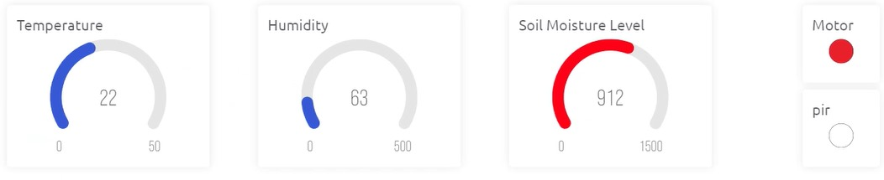
Results
We use Blynk (Iot platform) to display data on our mobile as it is very professional and easy to use for users.

Slide 13

Thank you

